Slide 1
NetSparker
Found Vulnerabilities

Slide 2
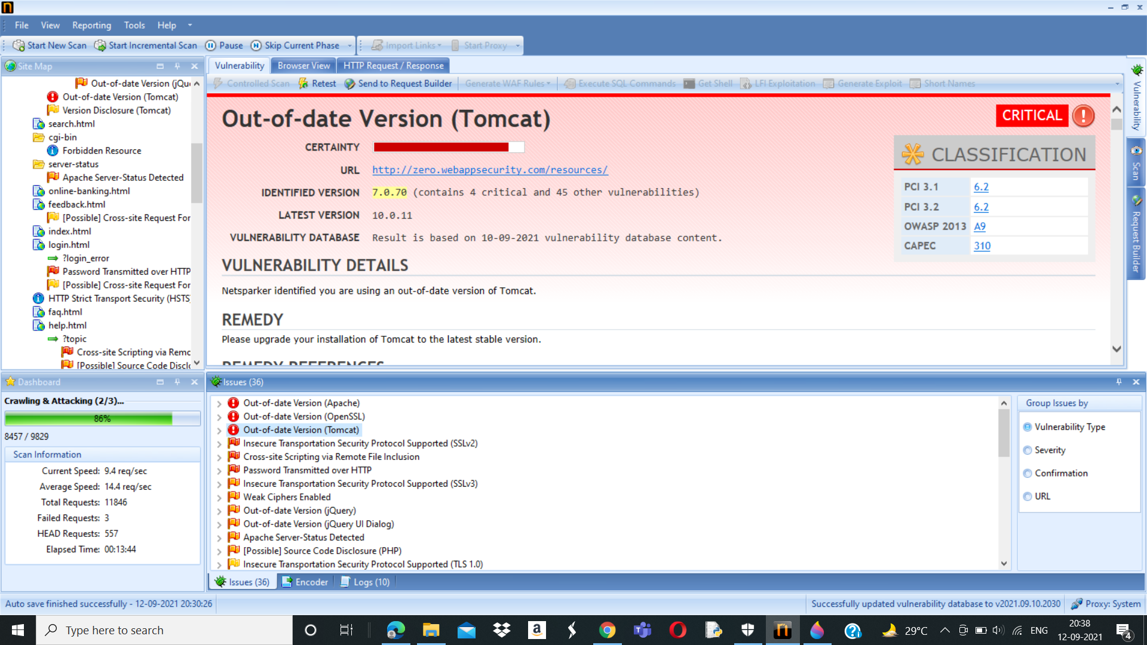

Slide 3
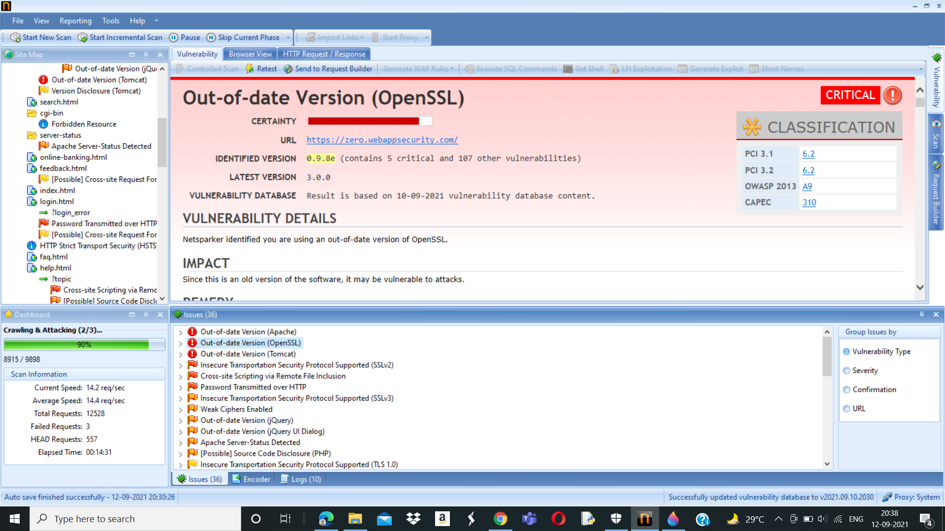

Slide 4


Slide 5
NetSparker’s Detailed Scan Report
Below will be the image by clicking on it we get the scanned report of vulnerabilities found by NetSparker.

Slide 6
My Report
Title:-Critical Vulnerabilities Found By NetSparker
Domain:- webappsecurity.com
Subdomain:-http://zero.webappsecurity.com/
Steps To Reproduce: 1.) Add Website you want to s to the dialogue box.
2.) Define the customization option to scan as per your need.
3.) It will start scanning it automatically.
4.) Choose any one of the Critical Vulnerabilities.
5.) Write Reports for the vulnerability you wanted to write. Make sure the report should not be the same as in Netsparker.
Impact:- NetSparker identified 3 critical vulnerabilities which is out-of-date version. Since the software is of old version, it may be vulnerable to attacks.
Remedy:- The user should upgrade the installation of all the out-of-date version into the latest stable version so that it will be easy in using this website.
POC:- Screenshots of Vulnerability found.

